Slide 1
Waste classification
Deep learning homework project By: Anna Gergály, Mészáros Péter

Slide 2
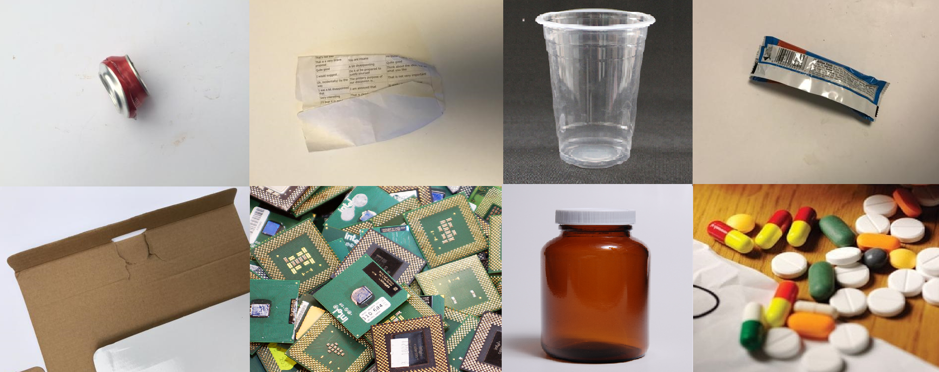
Goals
Possible aid in automatic waste sorting
Image classification
Separate recyclables (e.g. paper, plastic, metal)
Non-recyclables and hazardous waste

Slide 3
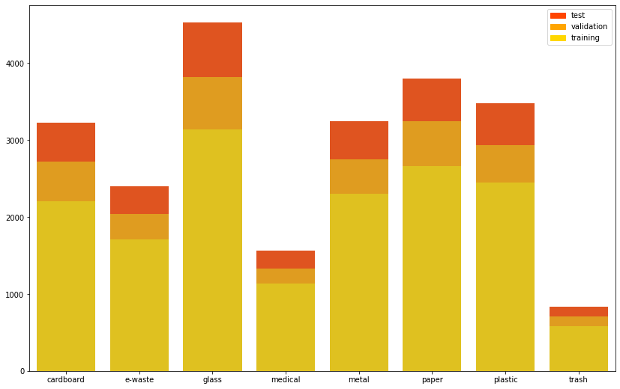
Datasets
Three datesets merged (Kaggle and Github) ~23.000 images
Waste items in various locations
Eight categories, five recyclable, three non-recyclable
14:3:3 train:validation:test split
Data-augmentation

Slide 4
Transfer learning models
Considered factors: size, inference time, accuracy
Chosen models: EfficientNetB5 and MobileNetV2
Imagenet weights used
Added layers to fit the problem, trained those layers
Fine-tuning only on the MobileNet

Slide 5
Our model
CNN built from scratch
Three branches with convolutional blocks
Convolutional layers with 5x5 and 3x3 kernels
Dropout
MaxPooling and AveragePooling
About ~2-3 million parameters

Slide 6
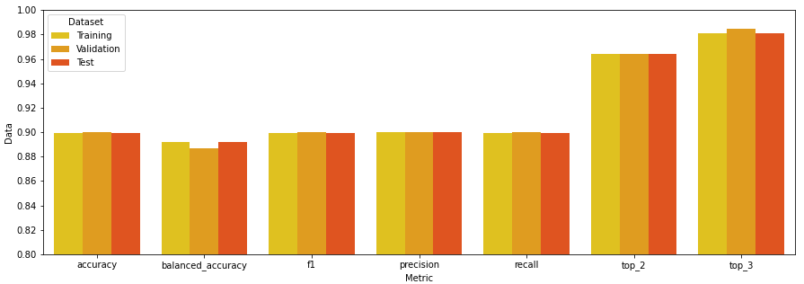
Results
Transfer learning models achieved 83-89% accuracy
EfficientNet had the best results – it is the largest model by far
Our model fared worse but was still better than random chance
Small number of training images (compared to imagenet)
Fairly small model

